Slide 1
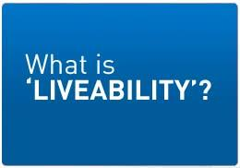
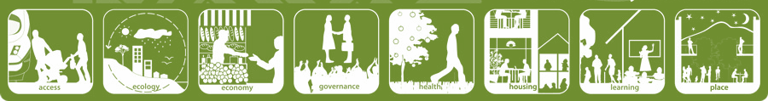
Lesson 3

Slide 2

'Liveability' - the qualities of a place (city, town, suburb, neighbourhood) that contribute to the quality of life experienced by residents and others.

Slide 3
‘Liveability’ – Cities
location
Urban? Rural, remote?
Resources
Water, electricity, gas, sanitation
Communications
Road, phone, internet, public transport, shipping
Services
Health, education, housing, entertainment, cleanliness, safety - police
Economy
Stable, flourishing? – trade, GDP
Government
Performance, policy – environment, crime rates, tax etc
Geography
Climate, terrain, location

Slide 4

Most & Least ‘Liveable’ Cities
http://www.telegraph.co.uk/travel/10270269/The-worlds-most-liveable-cities-2013.html?frame=2654758
http://www.telegraph.co.uk/travel/travelnews/10270633/The-worlds-least-liveable-cities-2013.html

Slide 5


Most & Least ‘Liveable’ Cities
https://www.youtube.com/watch?v=s7JkpEHau3o
Create a iMovie Trailer of the most and least ‘liveable’ cities in the world

Slide 6
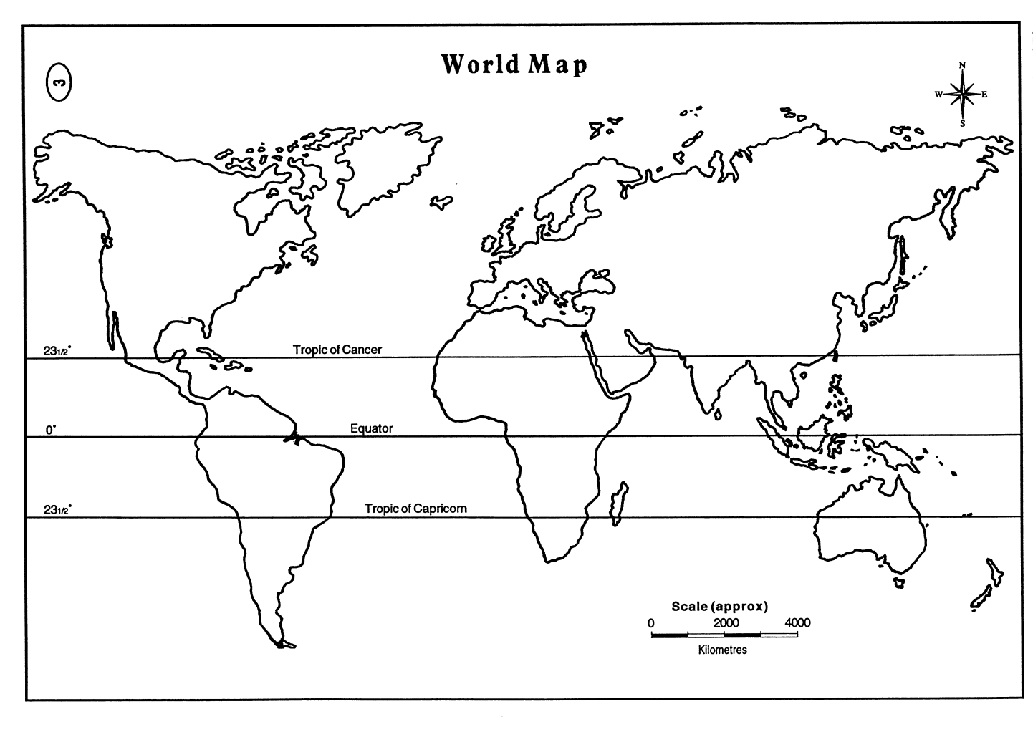

Mapping the
Most & Least ‘Liveable’ Cities

Slide 7

Bangladesh
Legend
Melbourne
Liveable
Unliveable
‘Liveability’

